Slide 1
Christopher Hyde
Southern New Hampshire University: IT 412
Final Project
Risk Analysis and Mitigation Plan
10/21/2018

Slide 2
Risk Overview
IT Structure is somewhat lacking
No guidelines followed when it was created
Network Administrator did not secure network properly
Data Server is vulnerable to breach by hackers due to hardware and software deficiencies
Physical Layout of office presents security risks

Slide 3
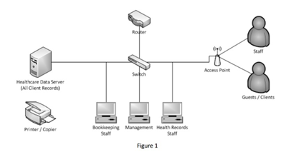
Current Information Technology Structure
Network Setup
Notes:
The data server for the healthcare data stores patient healthcare records, billing information, company financials, and various forms. It is connected through a switch to the other departments, including Bookkeeping, Health Records staff, and Management. There is also a wireless access point that allows guests, clients and other staff to access the network. In the front office, there is a copier/printer.

Slide 4
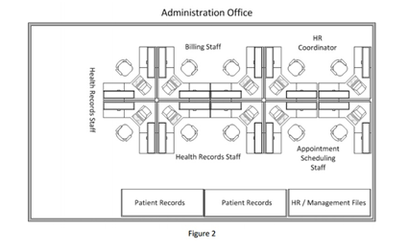
Current Information Technology Structure
(Con’t)
Physical Layout of Office
Notes:
The Billing staff, Health records Staff, Appointment scheduling staff and HR coordinator all have adjoining cubicles. The patient records, HR files, and management files all reside in filing cabinets in the same office. There is also a video monitoring system in place within the office.

Slide 5

CyberLaws and Ethics Regulations
Hacking
Breaking into someone’s computer electronically in order to gain access to sensitive information for financial gain.

Slide 6
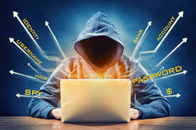
CyberLaws and Ethics Regulations (Con’t)
Identity Theft
The theft and use of someone’s personal information for financial gain (i.e. opening accounts in their name).

Slide 7
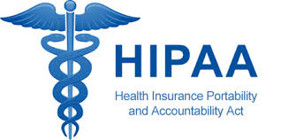
Ethics Violations (Professional)
Clear violations of The Health Insurance Portability and Accountability Act (HIPAA) which was created in 1996 by Congress to establish provisions for the safeguarding of Protected Health Information
PHI includes names, street address (with zip codes), birthdates, phone numbers, fax numbers, email addresses, social security numbers and medical record numbers
Notes:
“Protected health information is the term given to health data created, received, stored, or transmitted by HIPAA-covered entities and their business associates in relation to the provision of healthcare, healthcare operations and payment for healthcare services.” (HIPAA, 2018).

Slide 8
Threat Impact on IT
Software and network equipment still have default usernames and passwords
Unauthorized users can anyone can easily lookup the default usernames and passwords from the manufacturer’s website and gain access to sensitive information
Having no Acceptable Use Policy on Technology (Computer, internet, email) increases the likelihood of an intentional or unintentional breach
Network is susceptible to Spyware and Phishing

Slide 9
Cyberlaw Non-Compliance
Previous Cases
Year Company Records Compromised Cause
2015 Anthem Inc 78.8 Million Hacking
2015 Premera Blue Cross 11 Million Hacking
2015 Excellus Health Plan 10 Million Hacking
Notes:
“The three main causes of security breaches in healthcare in the last three years were hacking/IT incidents, unauthorized access and disclosure incidents, and the loss/theft of physical records and unencrypted electronic devices containing ePHI. …. In 2017, hacking/IT incidents were the main cause of healthcare data breaches.” (HIPAA Journal)

Slide 10
Impact on Business
Healthcare Companies are a major target for breaches
Data at risk for compromise include medical information as well as financial records
ABC Healthcare is Legally obligated as a healthcare provider under HIPAA
Violations could incur hefty penalties and jeopardize credibility

Slide 11
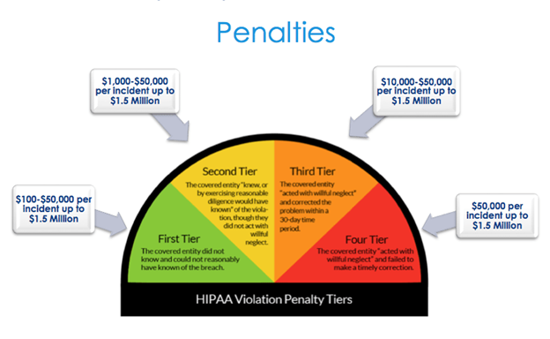
HIPAA Violation Fines
This chart depicts the penalties for HIPAA violations
Notes:
In February 2018 Fresenius Medical Care incurred $3.5 million in HIPAA fines for allowing 5 breaches to occur. Memorial Healthcare Systems racked up $5.5 million in 2017 and, in 2016, Feinstein Research paid $3.9 million in fines for improperly disclosing the records of research patients. (Compliancy Group, 2018)

Slide 12
RISK MITIGATION
All records should be protected using multi-layered Defense-in-Depth Measures.
The steps include:
Data Encryption per National Institute of Standards and Technology standards
Anti-Virus Software (Updated Regularly)
Firewall Hardware
Dedicated server Room with Security Door
Locking Paper Files in a seperate room with limited access
Electronics security door at main entrance
Security Guard or Fencing around perimeter of building

Slide 13
Risk Mitigation (Con’t)
Offering training programs to employees.
Hiring employees who are certified in cybersecurity.
Being aware of new security threats and update software as necessary.
Create and Publish a Breach Notification Policy to establish how, when and under what criteria patients should be made aware that their information has been compromised

Slide 14
Acceptable Use Policy Proposal
Standard Terms such as prohibiting the following:
Obscene, offensive, or pornographic images over the internet or through email
Transferring copyrighted materials
Attempts to try and to gain access to unauthorized systems
Notes:
ABC Healthcare does not currently have an Acceptable use policy. Developing one as soon as possible will protect the company from liability and potential cyber threats.

Slide 15
Acceptable Use Policy Proposal (Con’t)
Additional Terms
Minimum Password Length and complexity
Downloading, either intentionally or unintentionally, software that hasn’t been authorized by the company administrator
Visiting websites that may potentially be harmful to the network and compromise data
Engaging in activities that are fraudulent or criminal with regard to patient medical records or financial information

Slide 16

Code of Ethics
The company should abide by a Code of Conduct that should be both ethical and support the organization’s goals as well. This ethical behavior should be maintained at the management (professional) and the individual level (personal).
Notes:
…“Covered entities are defined in the HIPAA rules as (1) health plans, (2) health care clearinghouses, and (3) health care providers who electronically transmit any health information in connection with transactions for which HHS has adopted standards”.(NIH, 2018) As a covered entity, they are subject to the laws and ethics regulation put forth by the government and HIPAA.

Slide 17
Personal Code of Ethics
Employees must be made aware of the video monitoring system and agree to the terms, otherwise it is a violation of their right to privacy
Internal communications (verbal, email, and fax) should be conducted in a professional manner
Employee requirement to sign Non-Disclosure agreement to assure patient confidentiality
Workplace Harassment and bullying is unacceptable and subject to occupational health and safety laws
Management should perform annual Performance Reviews to assure their employees are meeting corporate goals and following policies

Slide 18
Professional Code of Ethics
Federal and Local Safety Rules & Regulations must be posted and followed
A Breach Notification Policy is to be created and published to establish how, when and under what criteria patients should be made aware that their information has been compromised
Labor Rights defined as for as maximum hours, vacation and sick time.
Data Disposal guidelines are to be put in place for when and how records are destroyed

Slide 19
References
(SNHU, 2018). Image [ABC Healthcare Computer network] retrieved from https://learn.snhu.edu/d2l/lor/viewer/viewFile.d2lfile/102846/21794,2/
(SNHU, 2018). Image [ABC Healthcare Office Layout] retrieved from https://learn.snhu.edu/d2l/lor/viewer/viewFile.d2lfile/102846/21794,2/
Albert,K. (2018, Apr 6). Image [Hacking]. Retrieved from https://www.dignited.com/31529/hacking-vs-cracking-difference/
(Defendershield, 2016) Image [Identity Theft] Retreived from https://www.defendershield.com/concealshield-protection-identity-theft-digital-pick-pocketing
Greevy, H (2017,Apr 12). Image [HIPAA] Retrieved from https://www.paubox.com/blog/what-is-hipaa
Grama/Spinello. (2015) Southern New Hampshire University IT412. Retrieved from https://mbsdirect.vitalsource.com/#/books/9781284082654/cfi/194!/4/4@0.00:47.8

Slide 20
References (Con’t)
(HIPAA, 2018) Jan 10. What is Protected Health Information. HIPAA Journal. Retrieved from https://www.hipaajournal.com/- what-is-protected-health-information/
Grama/Spinello. (2015). Risk Assessment. Southern New Hampshire University IT412. Retrieved from https://mbsdirect.vitalsource.com/#/books/9781284082654/cfi/194!/4/4@0.00:47.8
Compliancy Group (2018). What is the Penalty for a HIPAA Violation? Compliancy Group. Retrieved from https://compliancy-group.com/hipaa-fines-directory-year/
HIPAA Journal (2018). Security Breaches in Healthcare in the Last Three Years. HIPAA Journal. Retrieved from https://www.hipaajournal.com/security-breaches-in-healthcare-in-the-last-three-years/
(NIP, 2015) Image [Code of Ethics]. Retreived from https://www.psynip.nl/en/dutch-association-psychologists/code-of-ethics/code-ethics-2015/

